Slide 1
Social Media Engagement
Dale Deans

Slide 2
What topics bring in the most impressions and engagements?
Focus: Cooledture’s Instagram reels insights. Looking at Cooledture’s social media platforms, these post from the naked eye seems to garner the most attention, making it easier to gather meaningful data.

Slide 3
Preprocessing
Combined hashtags into one column, creating a list of strings for each post
Created a ‘category’ column and manually assigned a category for each post
Created ‘year’ and ‘month’ columns and used loop functions to return those respective years and months for each post

Slide 4
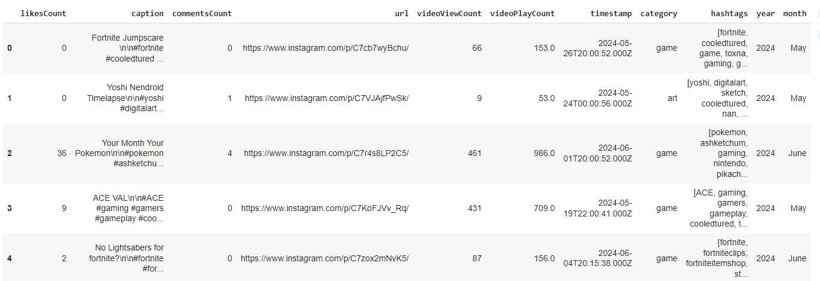
Preprocessed dataframe

Slide 5
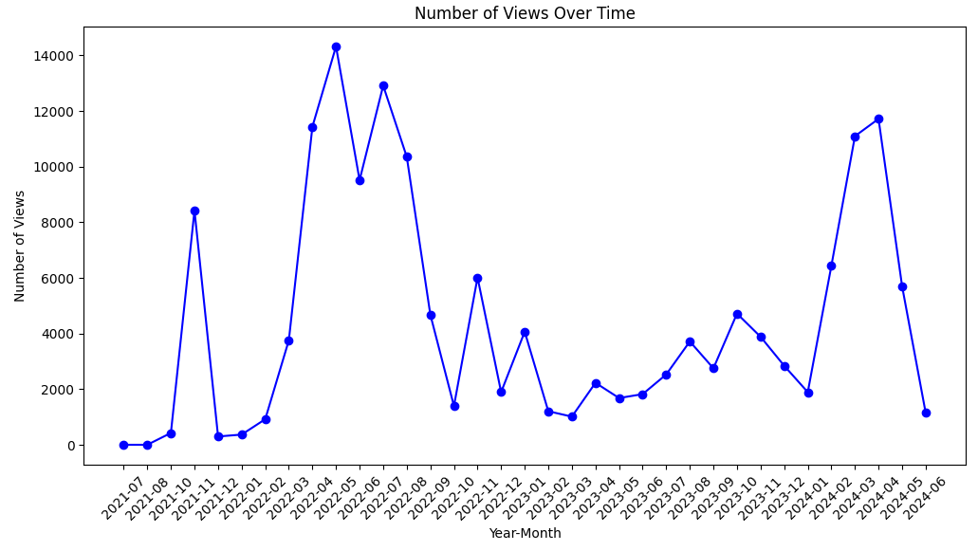
Yearly Trend 2021-22
A peak in 2022 followed by a bad drop in 2023 then a resurgence in 2024

Slide 6
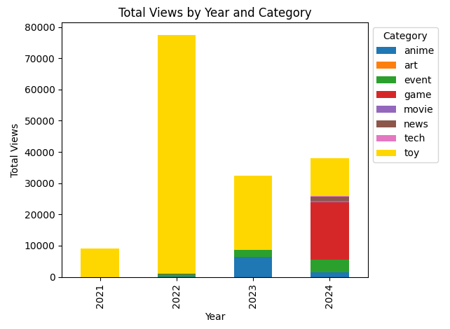
What has caused the resurgence?
Cooledtured instagram reels views are back on track and has even already surpassed 2023's totals
It is evident the introduction of reels that has to do with video games has played a big part in this, gaining a majority of the year's total views while the toy reels seem to continue on a decline

Slide 7
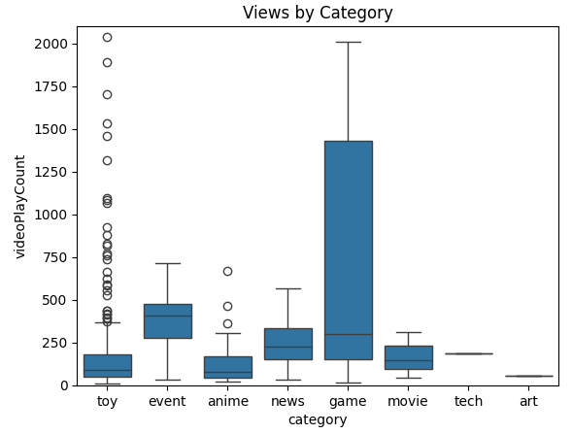
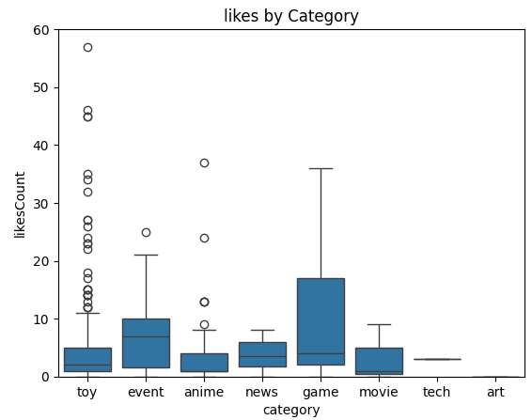
Box Plots
The boxplots above show that on average the game reels are bringing in more views and likes than the other categories

Slide 8
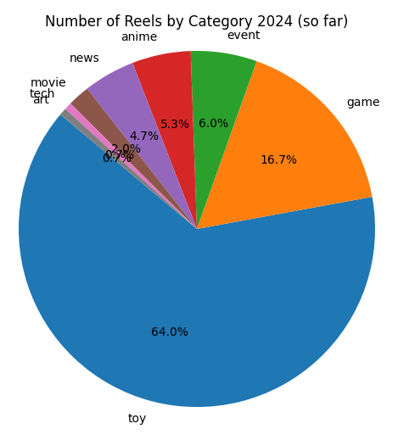
Pie chart
Actionable insight: Given how well the game reels have done in 2024 so far, Cooledtured should emphasize posting more of these type of reels considering it has played such an integral part in views and engagement garnered for the year.

Slide 9
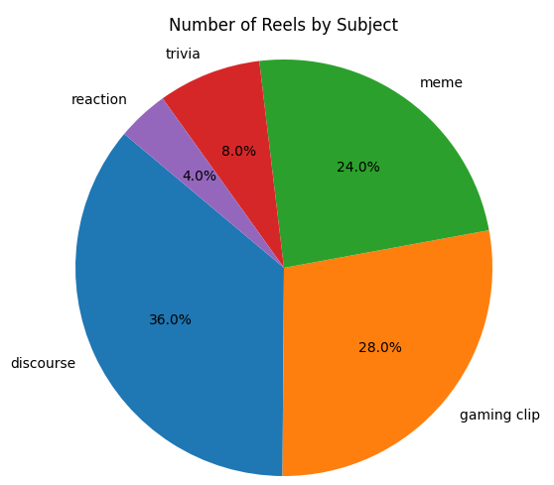
Which of the gaming reels are attracting user engagement the most?

Slide 10
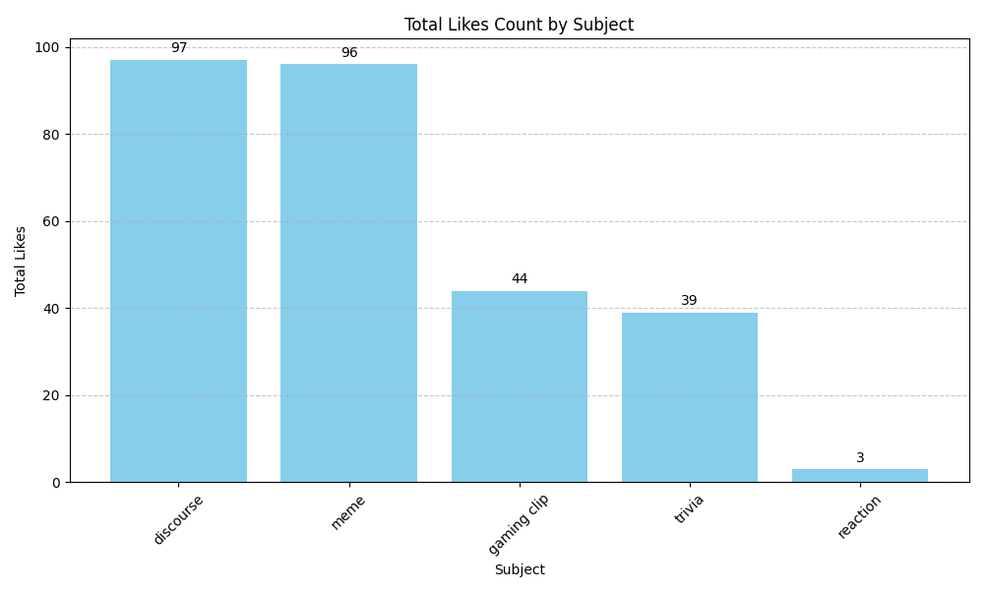
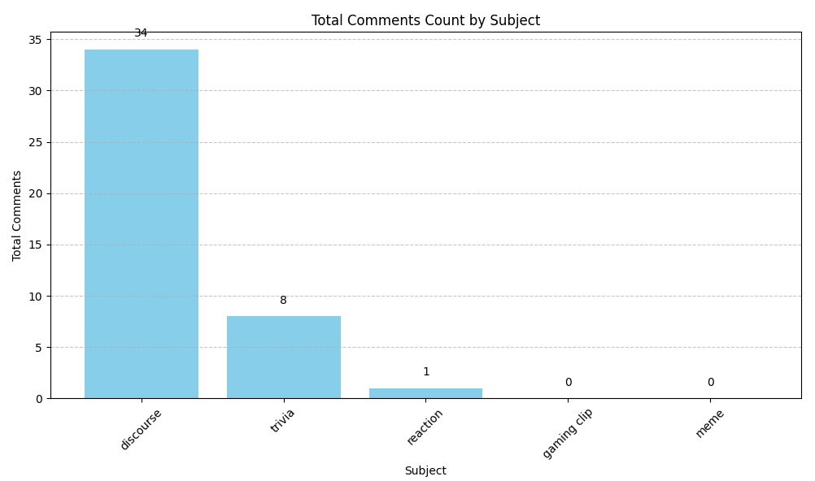
Total likes and comments by subcategory

Slide 11
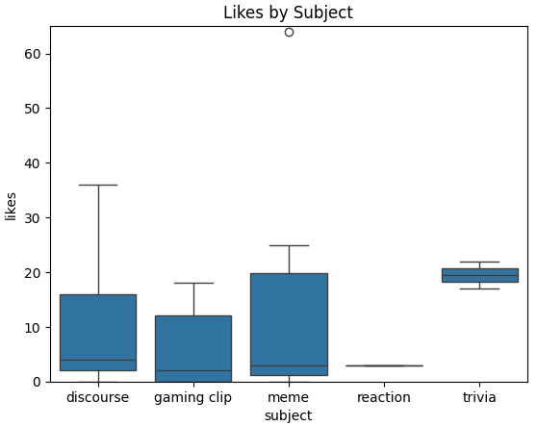
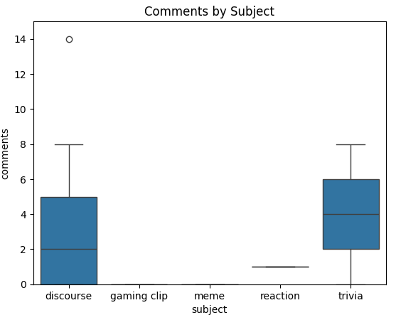
Subcategory box plots
There is pretty good distribution throughout the sub-categories
When it come to overall engagement, discourse game reels clearly are the best.
The trivia game reels, while only having 2 of those posted, do show promise as a the highest median in both boxplots.

Slide 12
Takeaway
Evaluating the pie chart, bar charts, and boxplots together, memes perform the best when its comes to getting likes while the discourse gaming reels do the best at gaining overall engagement. Trivia game reels shows promising of being a good attractor of overall engagements given its very small sample.

